Slide 1
STUDY OF LIPID PATTERNS OF SOME INDIGENOUS ANT SPECIES USING THIN LAYER CHROMATOGRAPHY BY SAROJ BISWAS REGISTRATION NO. - 10111220111020004 of 2011 Under The Supervision Of Dr. Indrani Datta Head, Department Of Molecular Biology , APC COLLEGE , Kolkata- 7000131
Notes:
1

Slide 2
INTRODUCTION
Ants are social insects of the family Formicidae and belong to the order Hymenoptera.
Many work has been done on the behavioral aspects of ants, the principal chemical aspects have been pheromones.
Comparative study on Indian ants at the biochemical level is still awaited. I, therefore, wanted to undertake a comparative study of lipids of a number of local (West Bengal, India) ant species. Ant species were collected from different places in West Bengal.
Sample of each species were identified from the Zoological survey of India.

Slide 3
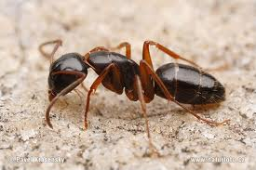
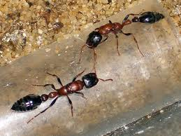
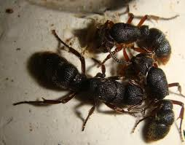
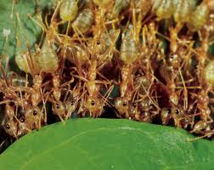
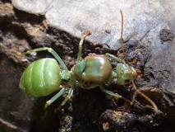
WORKING ON ANT SPECIES
Camponotus sp.
Diacamma sp.
Tetraponera sp.
Oecophylla smaragdina (worker)
Oecophylla smaragdina (reproductory morph)
Pachycondyla sp.

Slide 4
OBJECTIVES
Extraction of lipids from collected ants.
Analysis of lipids by thin layer chromatography.
Hydrolysis of polar lipids extracted from the different ant species.
Analysis of lipid composition from methyl ester of fatty acid from the different ant species.
Comparative study of lipid patterns of different ant species.

Slide 5
WORKING STRATEGY OF LIPID EXTRCTION
Different types of ants collected were weighed separately
Ants were homogenized separately and the homogenates were extracted individually with twenty volumes of chloroform-methanol mixture 2:1 (v/v) for extraction of lipid.
Add 0.2 volume of 1% NaCl to remove amino acids, sugars etc, from the chloroform-methanol extract .
Next day the lower organic layer containing lipids was removed and collected in a new test tube.

Slide 6
WORKING STRATEGY WITH TLC
Silica gel TLC plates (5cm x 10cm) were used
The standard (1% egg lecithin for polar lipid , 1% sunflower oil for non-polar lipids) and samples were spotted on the TLC plate 1 cm apart and 1 cm from edge
The TLC plates were placed in a TLC chamber lined with filter paper for chamber saturation and containing solvent system for polar or non-polar lipids
After completion of the run, the lipids were visualized by few crystals of iodine

Slide 7
WORKING STRATEGY WITH TLC
Iodine was then allowed to evaporate completely , for polar lipids, plates were sprayed with 2% Ninhydrin followed by heating at about 105ºC to visualize ‘amino’ lipids like PE, PS, LPE, LPS.
Another set of TLC plates (for polar lipids) was sprayed with Dragendorff’s reagent for the detection of phosphotidyl choline (PC) and sphingolipids (orange yellow color).
nonpolar lipids analysis was carried out by using petroleum ether : diethyl ether : acetic acid :: 80 : 20 : 1 (v/v). Lipid spots were visualized by iodine exposure and identification was done by comparison of standards.

Slide 8
WORKING STRATEGY WITH HYDROLYSIS OF POLAR LIPIDS
0.4ml of different lipid extracts were taken in glass tube and the solvent was allowed to evaporate completely
Then 0.1 ml of 2(N) Hydrochloric acid was added to each sample.
The lipid samples were hydrolyzed in a boiling water bath for 1.5 hrs
Acid was evaporated completely by placing the samples in a desicator overnight containing fused calcium chloride and sodium hydroxide
The samples were then dissolved in 0.1 ml water and analyzed by TLC with Butanol : Acetic acid : Water :: 8 : 2: 2 (v/v) as solvent

Slide 9
WORKING STRATEGY WITH METHYL ESTERS
Different dry lipid extracts were taken and the residue was dissolved in 2 ml of a mixture of methanol : benzene : H₂SO₄ ::84:10:4(v/v),the tubes were sealed and heated at (80⁰C-90⁰ C) for 2 hours.
After completion solution was poured in 5ml of H₂O, shaken and fatty acid methyl esters extracted thrice with 2 ml of hexane
The extracts was pooled and sodiumbicarbonate : anhydrous sodium sulphate ::1:3(w/w) mixture was added to free from acid & water.
The hexane extract was evaporated and re-dissolved in hexane and the fatty acid methyl esters were purified by TLC using n-hexane : diethyl ether ::95:5 (v/v) as solvent , developed with iodine , marked and eluted with chloroform and preserved at - 20⁰ C..

Slide 10
RESULTS

Slide 11
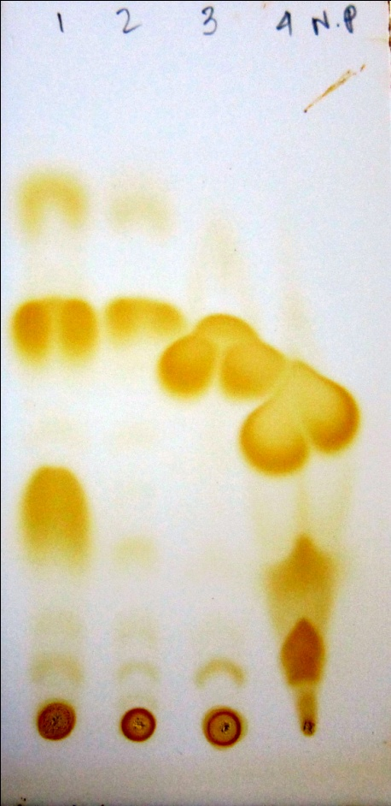
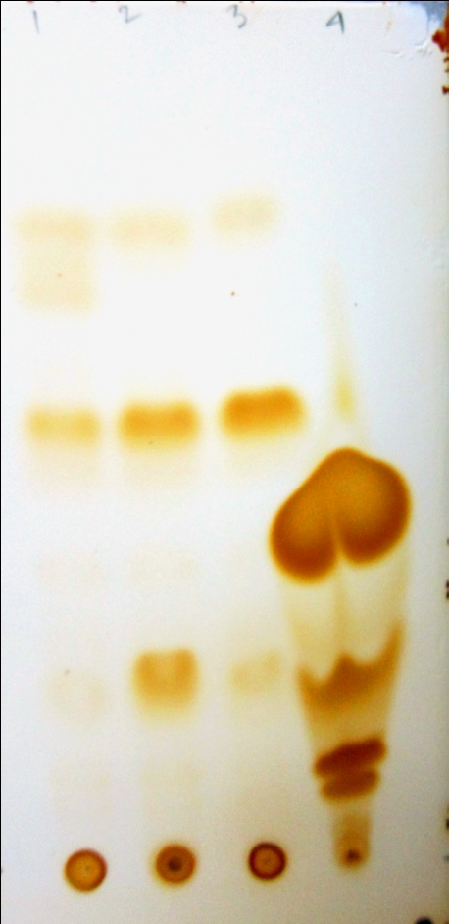
NON-POLAR LIPIDS
SE
TAG
DAG
1 2 3 4
Fig. 1: TLC for non-polar lipids
1-Pachycondyla spp.
2- Oecophylla smaragdina (worker)
3- Oecophylla smaragdina (reproductory morph)
4- Oil(standard)
1 2 3 4
Fig. 2 : TLC for non-polar lipids
1 – Tetraponera spp.
2 – Diacamma spp.
3 – Camponotus spp.
4- Oil(standard)
Note: Developed with Iodine. Ant spp. was from Barasat.
Solvent used for TLC: Petroleum ether: Diethyl ether: Acetic acid :: 80 : 20 : 1 (v/v)

Slide 12
Spots of diacylglycerol(DAG), triacylglycerol (TAG), sterol ester (SE) were seen easily with different intensities on chromatogram
TAG was most intense.
TAG was detected in lower amount in Oecophylla smaragdina (worker) than in Oecophylla smaragdina (reproductive morph). TAG was detected in significantly higher amount in Oecophylla smaragdina (reproductive morph) [fig.1].
In Pachycondyla spp. DAG & SE spots were much more intense than in Oecophyla smaragdina (worker & reproductive morph)[fig.1].
Camponotus spp., Diacamma spp., Tetraponera spp. also showed spots of TAG (most intense), DAG & SE (low amounts)(Fig.2).
Only Diacamma spp. from Barasat gave most intense spot of DAG, that indicates Diacamma spp. contains high amount of DAG & TAG(Fig.2).

Slide 13
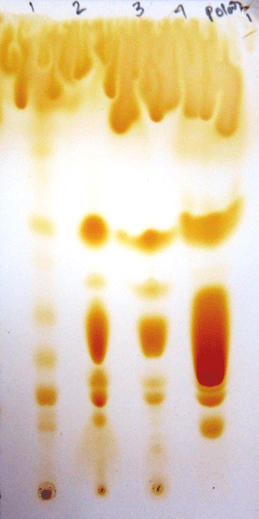
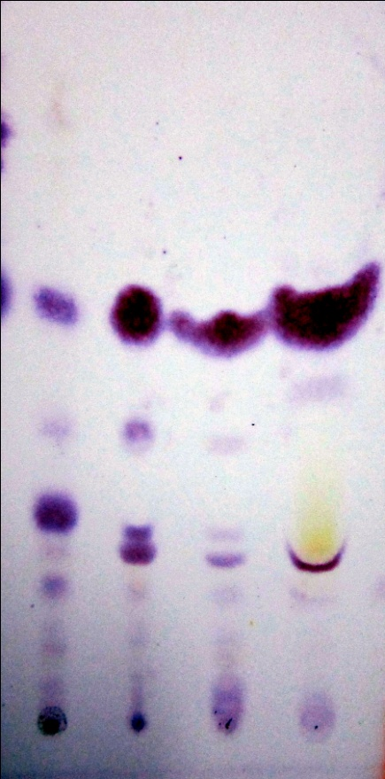
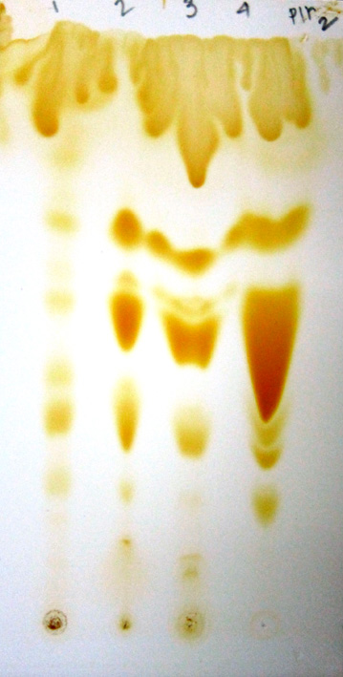
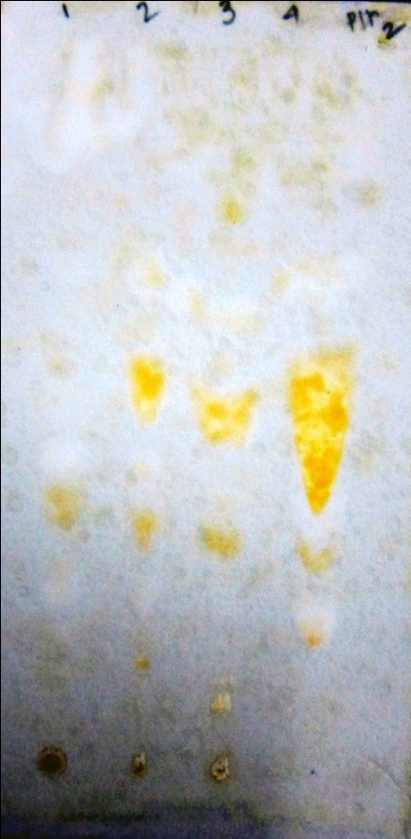
POLAR LIPIDS
PE
PE
PC
PC
LPE
LPE
PS
PS
PI
1 2 3 4
Fig. 3: TLC for polar lipids
1-Pachycondyla spp.
2- Oecophylla smaragdina (worker)
3- Oecophylla smaragdina (reproductive morph)
4- lechithin
Note: Developed with iodine
1 2 3 4
Fig. 4: TLC for polar lipids
1-Pachycondyla spp.
2- Oecophylla smaragdina (worker)
3- Oecophylla smaragdina (reproductive morph)
4- lechithin
Note: Developed with ninhydrin
1 2 3 4
Fig. 5: TLC for polar lipids
1-Pachycondyla spp.
2- Oecophylla smaragdina (worker)
3- Oecophylla smaragdina (reproductive morph)
4- lechithin
Note: Developed with iodine
1 2 3 4
Fig. 6: TLC for polar lipids
1-Pachycondyla spp.
2- Oecophylla smaragdina (worker)
3- Oecophylla smaragdina (reproductive morph)
4- lechithin
Note: Developed with Dragondroff’s reagent
Solvent used for TLC : chloroform: methanol: water:: 65:25:4 (Ant sp. was from Barasat)

Slide 14
Spots of phosphatidyl ethanolamine (PE), lysophosphatidyl ethanolamine (LPE), phosphatidyl serine (PS) , Phosphatidyl choline (PC) and possibly phosphatidyl inositol (PI) were detected.
Phosphatidyl choline (PC) could be detected in all the above species of ants except in Pachycondyla spp.
Oecophylla smaragdina (reproductive morph) contained significantly low amounts of phosphatidyl inositol (PI) [fig. 3 to 6].

Slide 15
1 2 3 4
Fig.7: TLC of polar lipids
1-Pachycondyla spp.
2-Oecophylla smaragdina (worker)
3- Oecophylla smaragdina (reproductive morph)
4-Lecithin
Note: Developed with iodine
1 2 3 4
Fig.8: TLC of polar lipids
1-Pachycondyla spp.
2-Oecophylla smaragdina(worker)
3- Oecophylla smaragdina (reproductive morph)
4-Lecithin
Note: Developed with ninhydrin & Dragendorff’s reagent
Solvent used for TLC: chloroform: methanol: ammonia:: 65:25:4

Slide 16
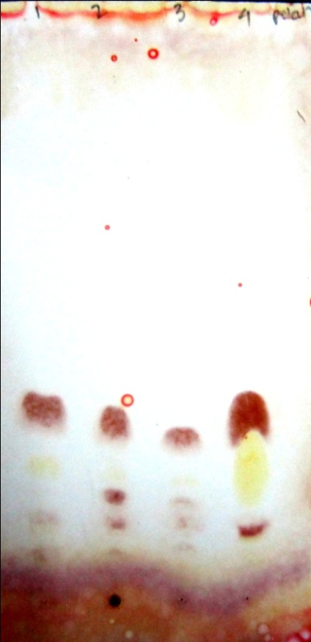
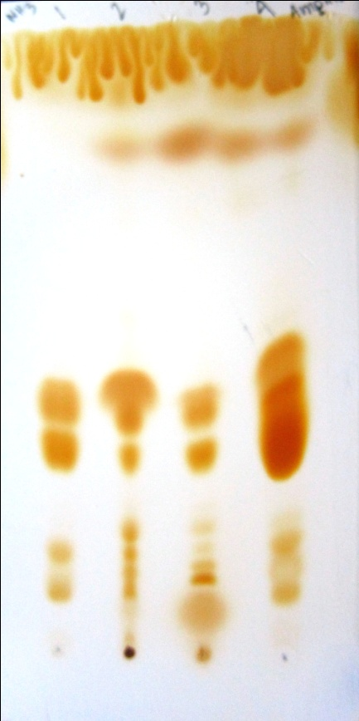
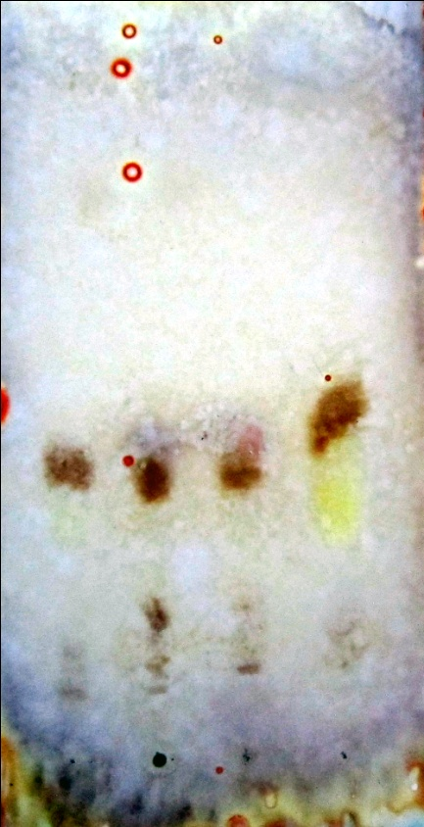
POLAR LIPIDS
PE
PE
PC
PC
LPE
LPE
PS
PS
PI
1 2 3 4
Fig.9: TLC for polar lipids
1-Tetraponera spp.
2-Diacamma spp.
3-Camponotus spp.
4-Lecithin
Note: developed with iodine
1 2 3 4
Fig.10: TLC for polar lipids
1-Tetraponera spp.
2-Diacamma spp.
3-Camponotus spp.
4-Lecithin
Note: Developed with ninhydrin & Dragendorff’s reagent
1 2 3 4
Fig.12: TLC for polar lipids
1-Tetraponera spp.
2-Diacamma spp.
3-Camponotus spp.
4-Lecithin
Note: Developed with ninhydrin & Dragendorff’s reagent
1 2 3 4
Fig.11: TLC for polar lipids
1-Tetraponera spp.
2-Diacamma spp.
3-Camponotus spp.
4-Lecithin
Note: developed with iodine
Ant spp. was from Barasat. Solvent used for TLC: chloroform:methanol:water::65:25:4 (for fig.9 & fig.10)
Solvent used for TLC: chloroform:methanol:ammonia::65:25:4 (for fig.11 & fig.12)

Slide 17
POLAR LIPIDS
Fig. 13: TLC for Polar lipids
1 – Camponotus
2 – Diacamma
3 – Tetraponera
4 – Lecithin (standard)
Note: Developed with iodine
Fig.14: TLC for Polar lipids
1 – Camponotus
2 – Diacamma
3- Tetraponera
4- Lecithin (standard)
Note: Stained with Ninhydrin
Fig.15: TLC for Polar lipids
1 – Camponotus
2 – Diacamma
3 – Tetraponera
4 – Lecithin (standard)
Note: Developed with iodine
Fig.16: TLC for Polar lipids
1 – Camponotus
2 – Diacamma
3- Tetraponera
4- Lecithin (standard)
Note: Stained with
Dragendroff’s reagent
Solvent used for TLC: chloroform:methanol:water::65:25:4 (Ant spp. was from Naihati)

Slide 18
HYDROLYSIS OF POLAR LIPIDS
1 2 3 4 5
Fig.17: TLC for polar lipids (after hydrolysis)
1-Serine
2-Tetraponera spp.
3-Diacamma spp.
4- Ethanolamine
5- Choline
Note: developed with Dragondorff’s reagent
1 2 3 4 5
Fig.18: TLC for polar lipids (after hydrolysis)
1-Serine
2-Tetraponera spp.
3-Diacamma spp.
4- Ethanolamine
5- Choline
Note: developed with Dragondorff’s & ninhydrin reagent
Solvent used: Butanol :Acetic acid : Water:: 80 :20:20 (Ant species were collected from Naihati.)

Slide 19
Different spots of lipids were observed after the polar lipid samples were analyzed by TLC before hydrolysis .
Spots of serine and ethanolamine in both the ant species could be identified after hydrolysis.

Slide 20
CONCLUSION
Different spots of lipids were observed after TLC of polar and non polar lipids.
Serine and ethanolamine could be identified after hydrolysis of the lipid samples of Diacamma spp. and Tetraponera spp. collected from Naihati.
From the MS analysis of methyl ester one fatty acid was identified as elaidic acid .

Slide 21
FUTURE ASPECTS
Identification of the different fatty acids by GC-MS.
The differences in the amounts of different lipids among the various ant genera has to be confirmed by Quantitative Analysis.
The differences in the amounts of the different lipids present in the various ant genera can be used as a taxonomic tool in future.
Whether these lipids act as pheromones or not.

Slide 22
ACKNOWLEDGEMENT
I sincerely thank my Project guide Dr. Indrani Datta, Head of the Molecular Biology Department of Acharya Prafulla Chandra College for the excellent guidance, encouragement and kind co-operation.
I wish to express my sincere gratitude to Dr. Prajna Mandal (HOD) of Microbiology of Acharya Prafulla Chandra College for giving me an opportunity to carry out my project work at this college.
I am obliged and thank Dr. Saroj Kanti Das for his cooperation and huge experience.
I am also obliged to Dr. Santanu Roy and Dr. Neena Mishra and very thankful to Gargi Mitra ex-student of M.Sc. Microbiology .

